Slide 1
Chapter 13
Digital Control Systems

Slide 2
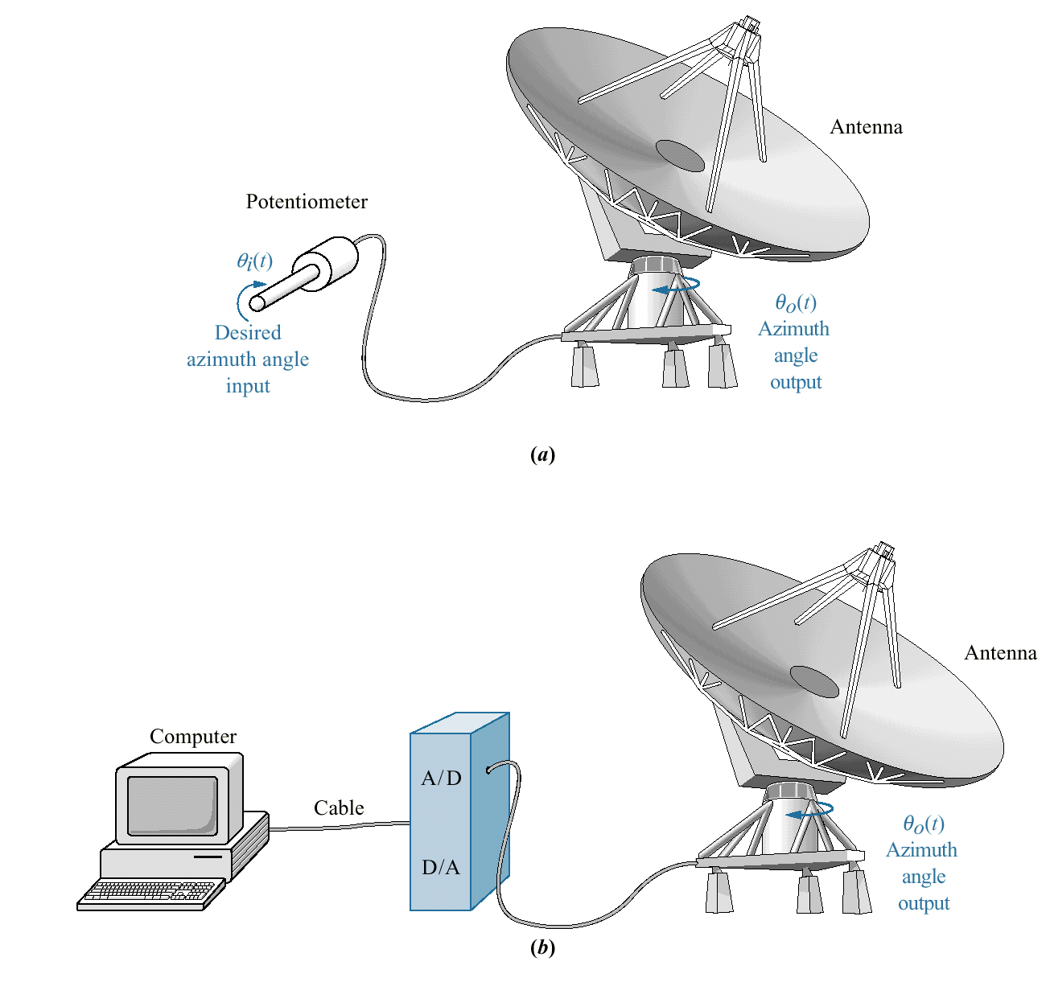
Figure 13.1
Conversion of antenna
azimuth position
control system from:
a. analog control to;
b. digital control

Slide 3
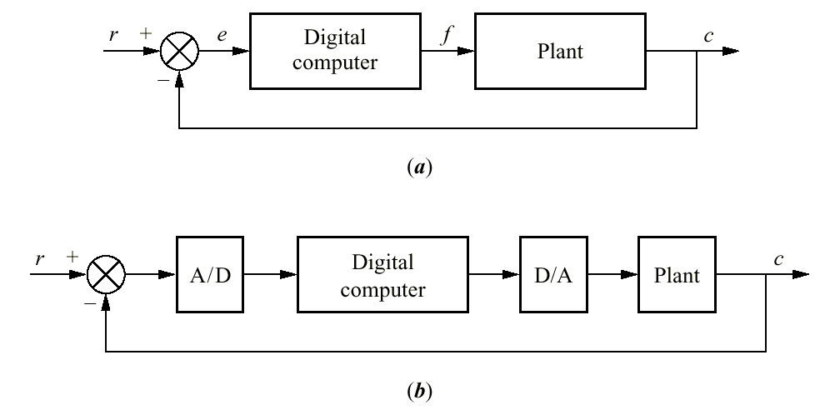
Figure 13.2
a. Placement of the
digital computer
within the loop;
b. detailed block
diagram showing
placement of A/D and
D/A converters

Slide 4
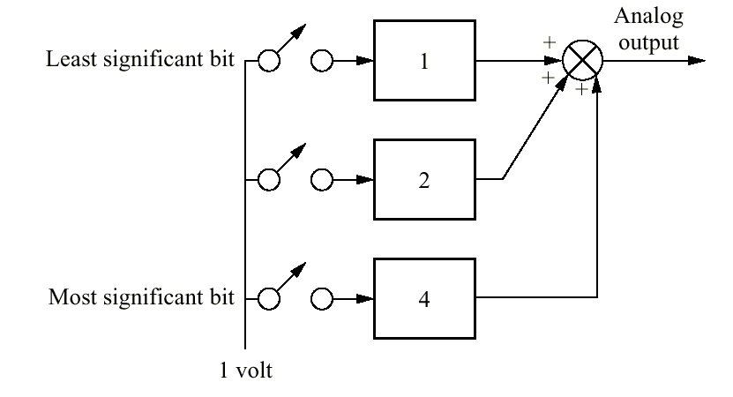
Figure 13.3
Digital-to-analog
converter

Slide 5
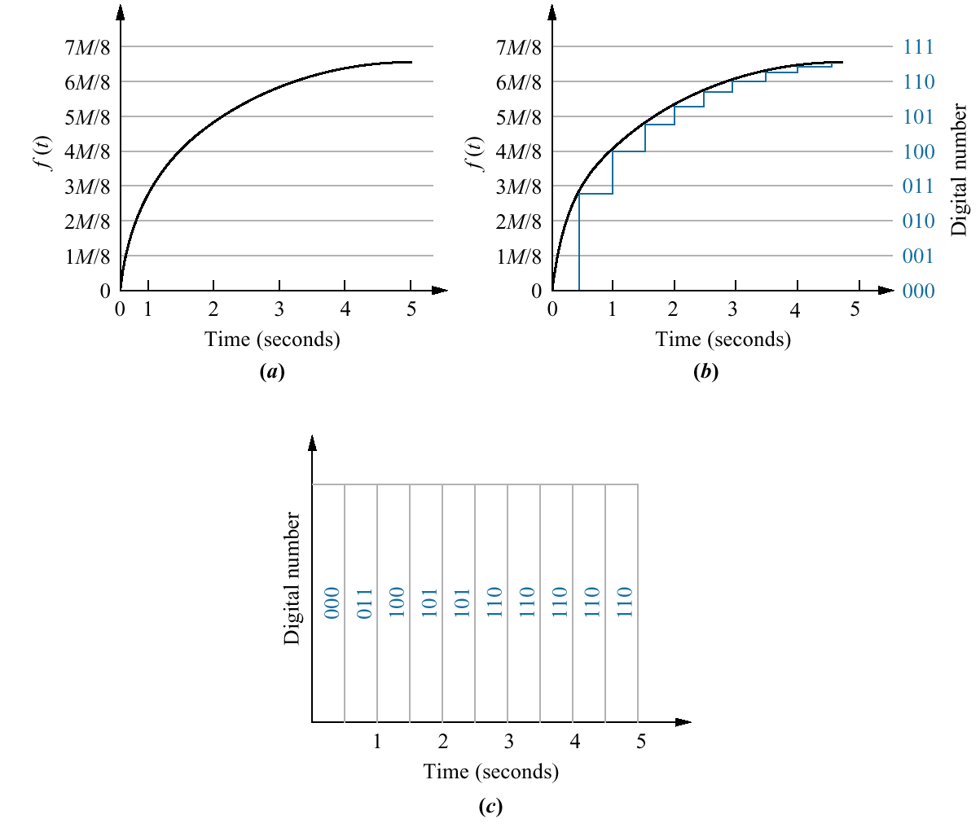
Figure 13.4
Steps in analog-to-
digital conversion:
a. analog signal;
b. analog signal after
sample-and-hold;
c. conversion of
samples to digital
numbers

Slide 6
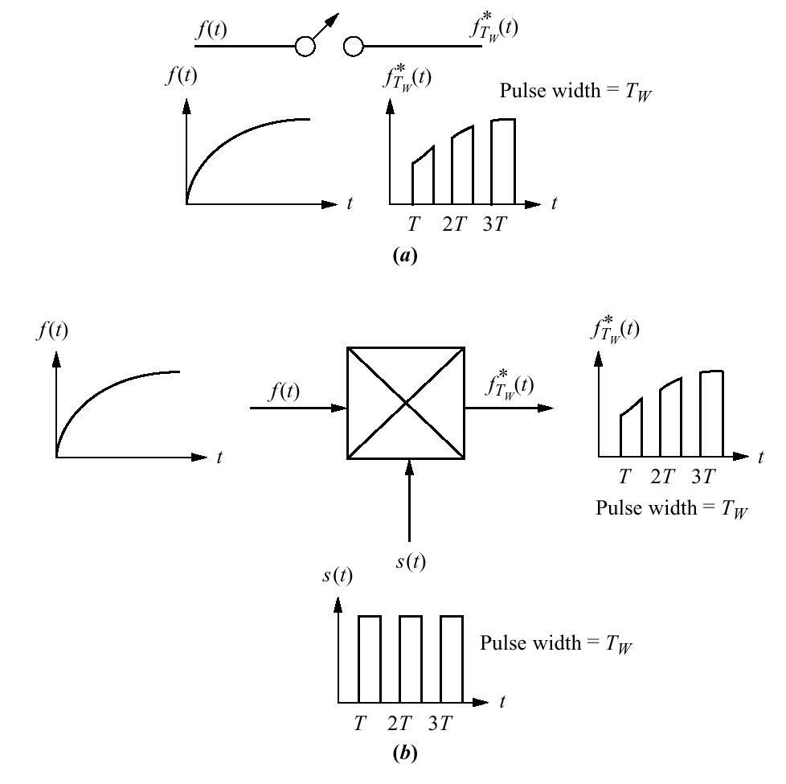
Figure 13.5
Two views of uniform-rate
sampling:
a. switch opening and
closing;
b. product of time
waveform and
sampling waveform

Slide 7
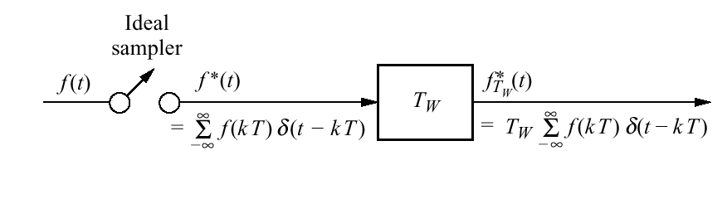
Figure 13.6
Model of sampling
with a uniform
rectangular
pulse train

Slide 8
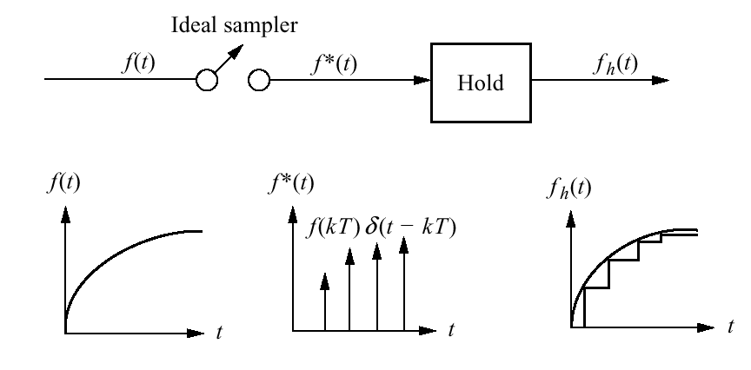
Figure 13.7
Ideal sampling and the
zero-order hold

Slide 9
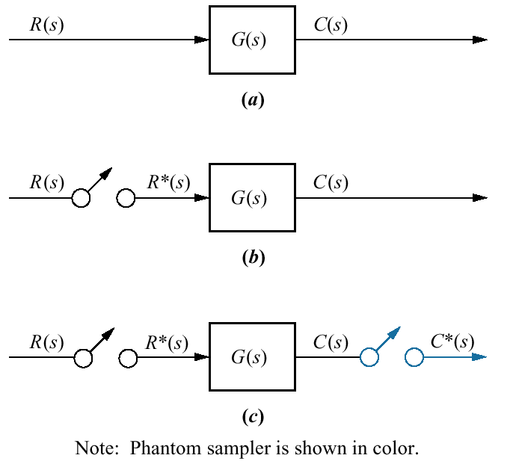
Figure 13.8
Sampled-data
systems:
a. continuous;
b. sampled input;
c. sampled input
and output

Slide 10
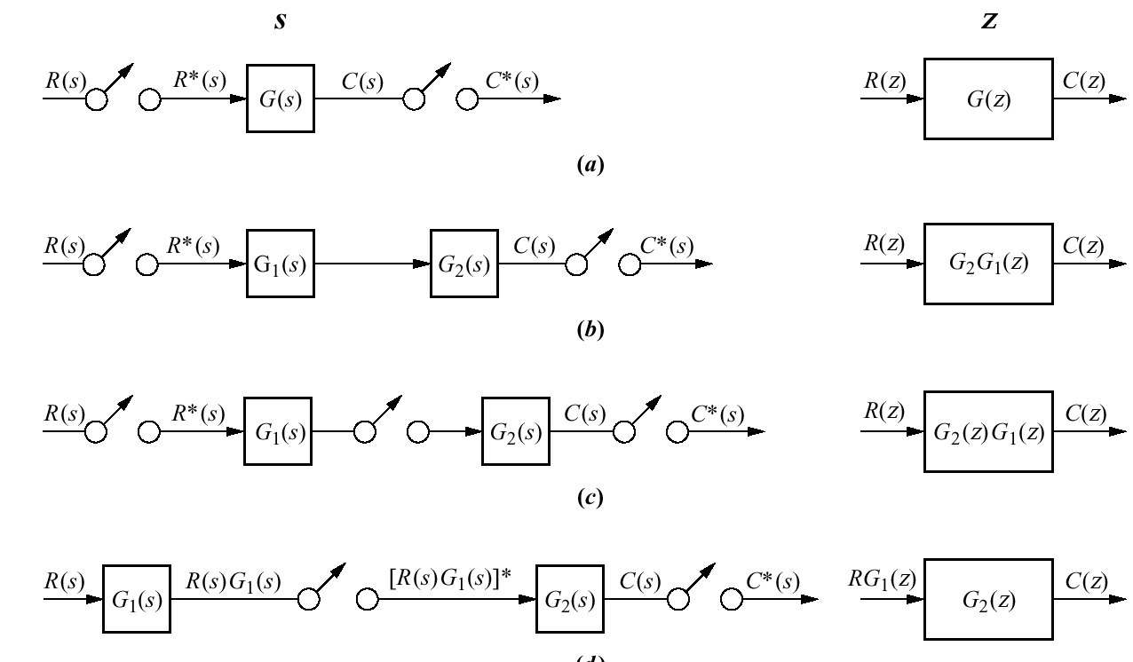
Figure 13.9
Sampled-data
systems and their
z-transforms

Slide 11
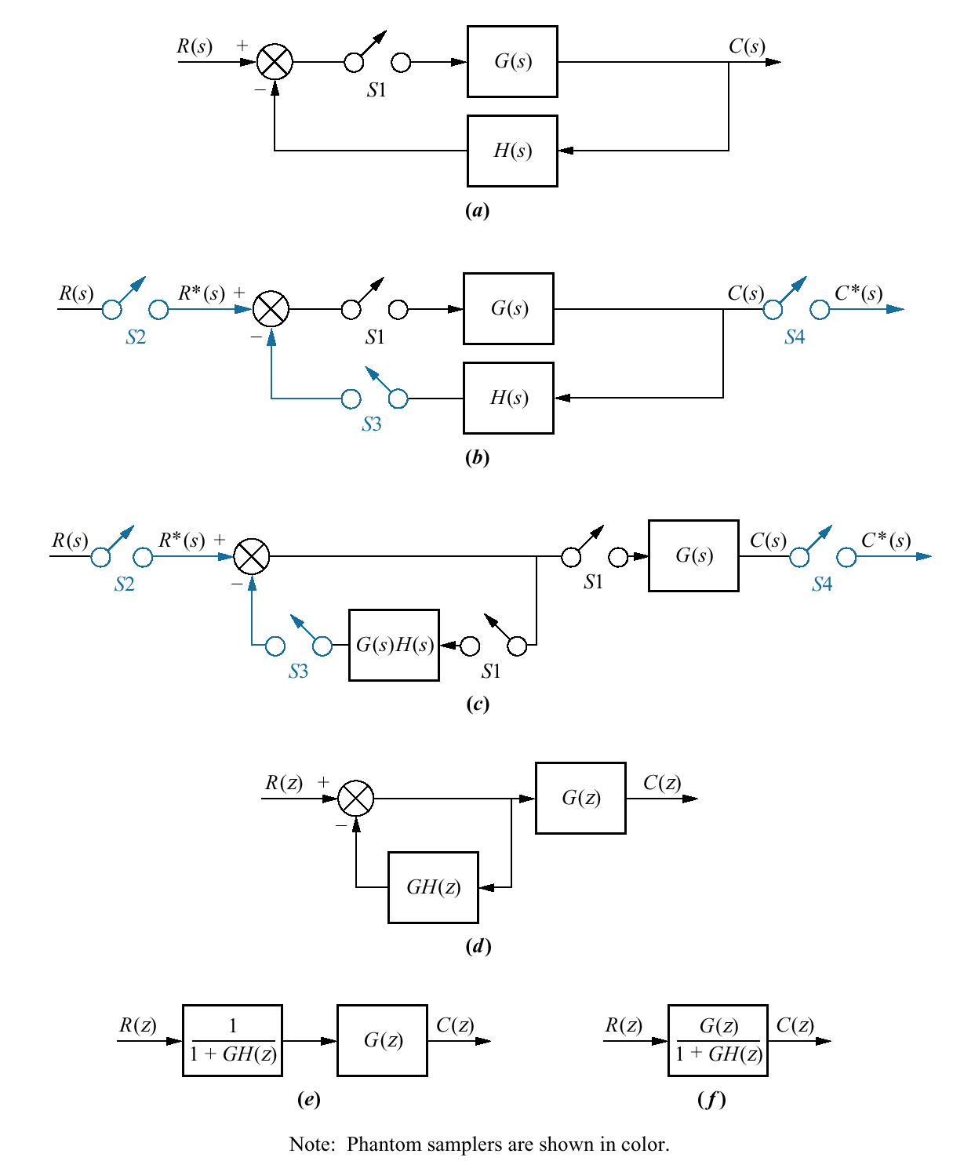
Figure 13.10
Steps in block
diagram reduction
of a sampled-data system

Slide 12
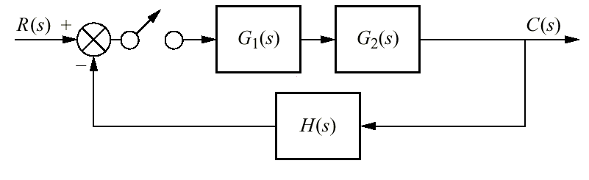
Figure 13.11
Digital system for
Skill-Assessment
Exercise 13.4

Slide 13
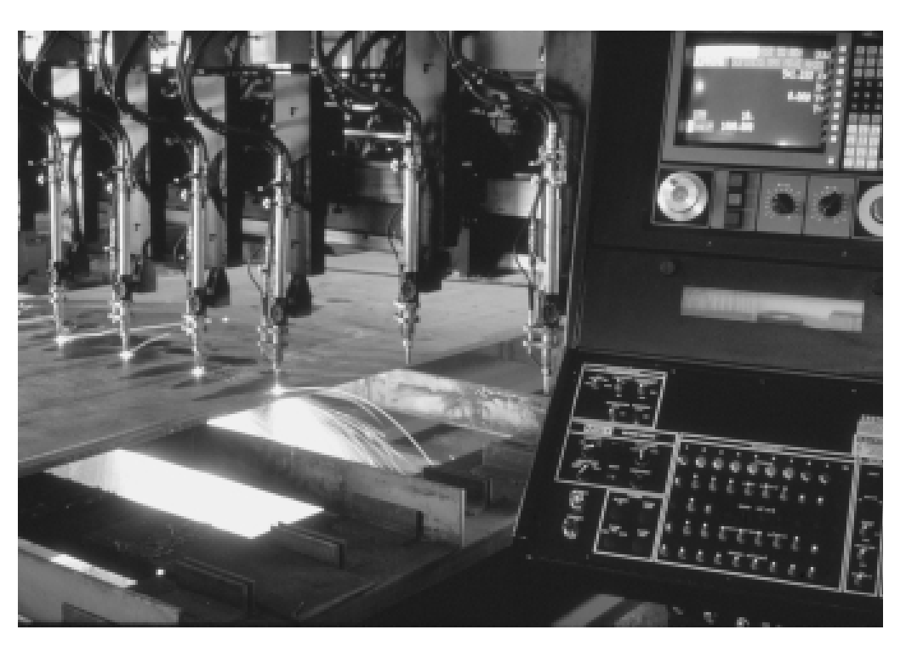
Figure 13.12
Computer-controlled
torches cut thick
sheets of metal used
in construction

Slide 14
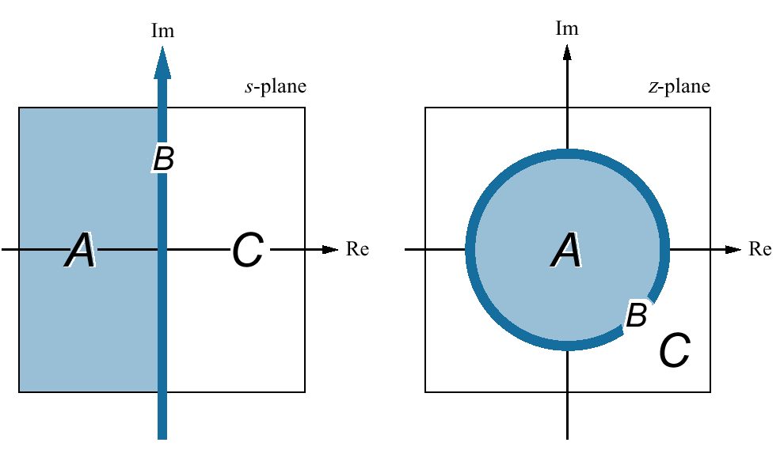
Figure 13.13
Mapping regions of
the s-plane onto
the z-plane

Slide 15
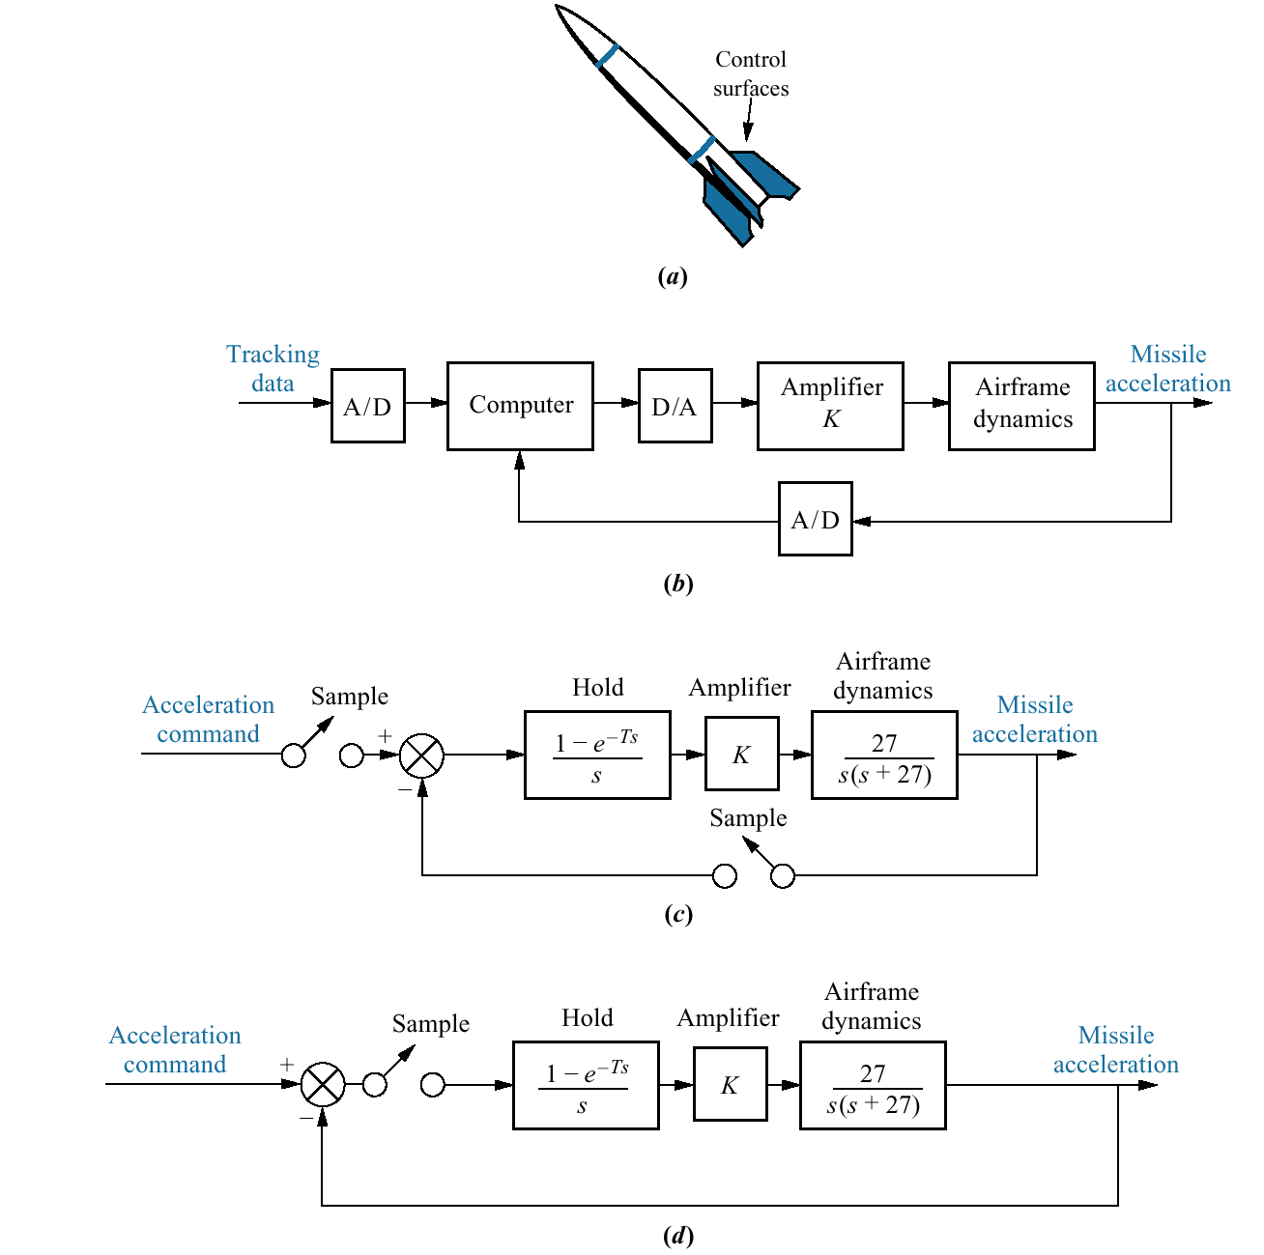
Figure 13.14
Finding stability of
a missile control
system:
a. missile;
b. conceptual block
diagram;
c. block diagram;
d. block diagram
with equivalent single
sampler

Slide 16
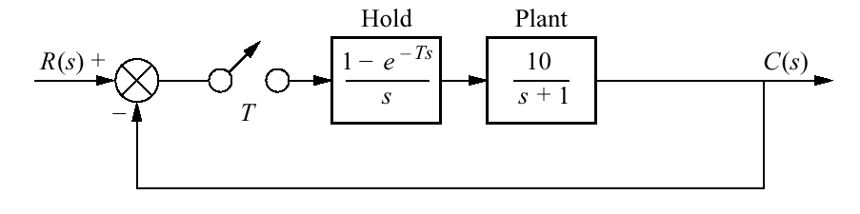
Figure 13.15
Digital system for
Example 13.7

Slide 17
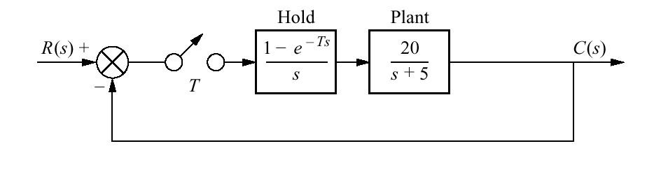
Figure 13.16
Digital system for
Skill-Assessment
Exercise 13.5

Slide 18
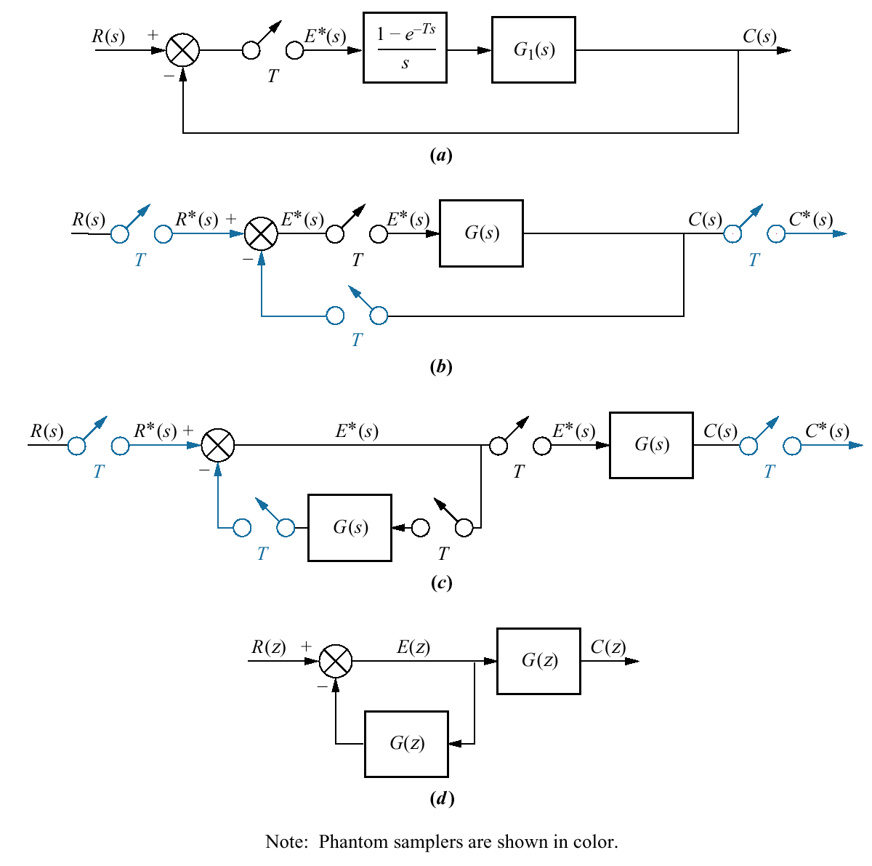
Figure 13.17
a. Digital feedback
control system for
evaluation of
steady-state errors;
b. phantom samplers
added;
c. pushing G(s) and its samplers to the right past the pickoff point;
d. z-transform
equivalent system

Slide 19
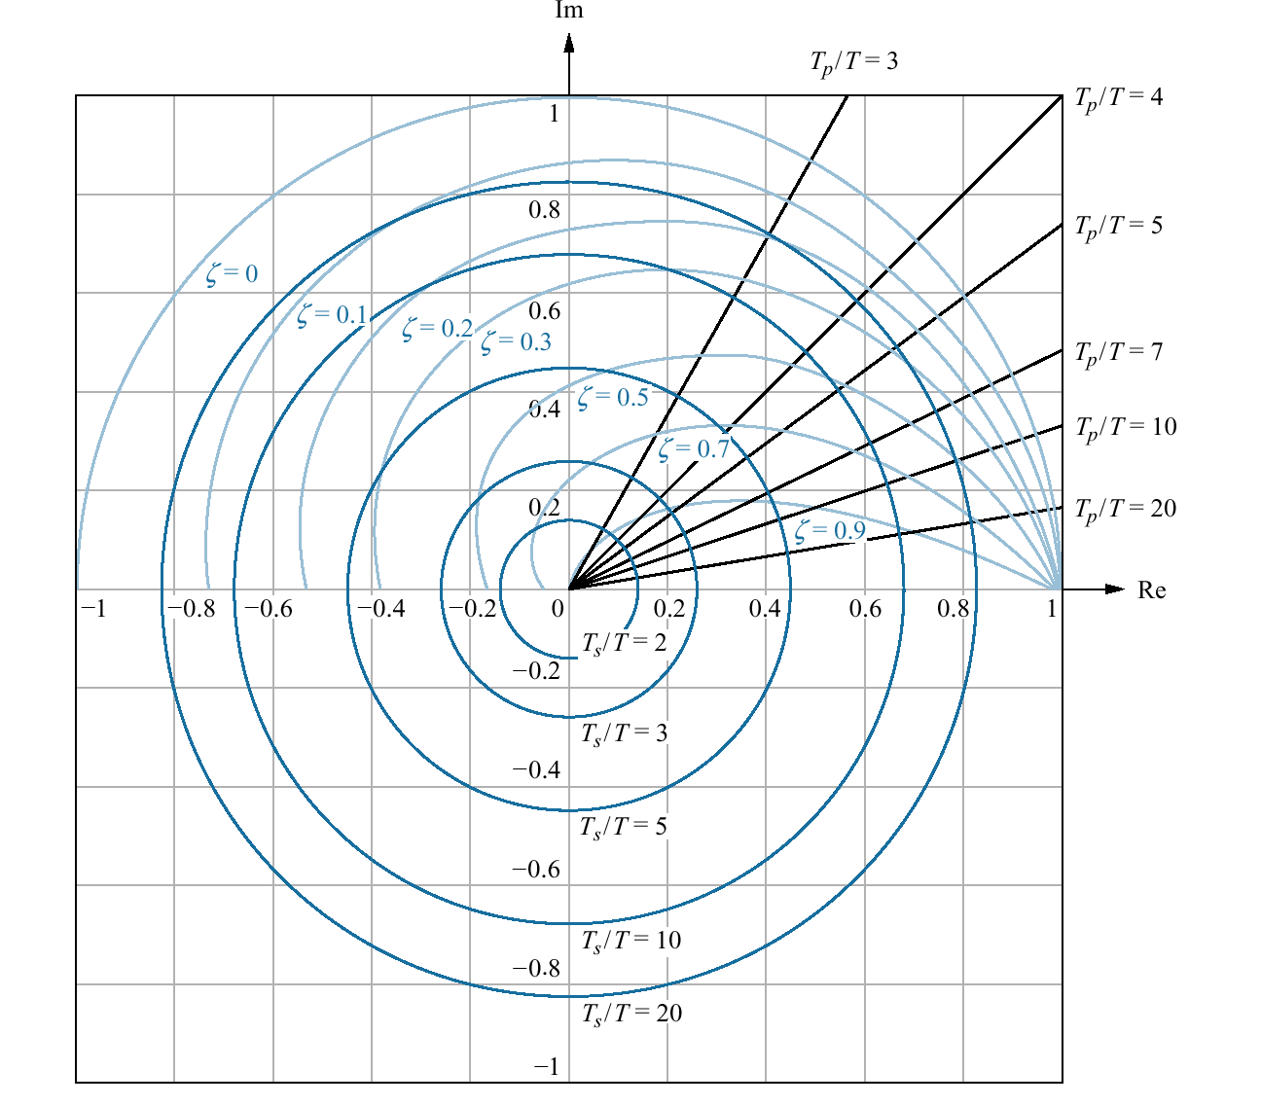
Figure 13.18
Constant damping
ratio, normalized
settling time, and
normalized peak time
plots on the z-plane

Slide 20
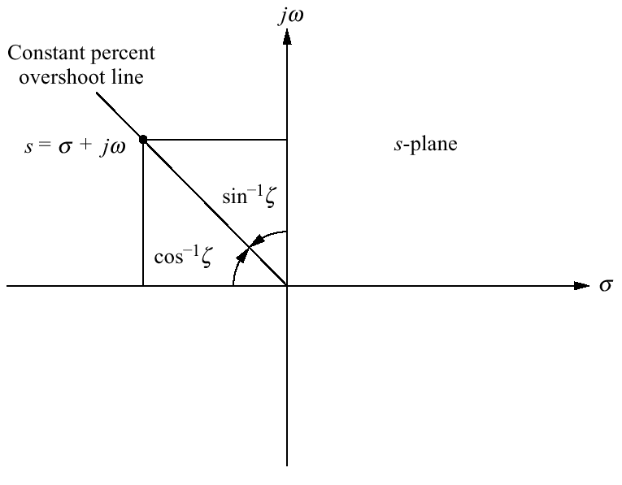
Figure 13.19
The s-plane sketch
of constant percent
overshoot line

Slide 21
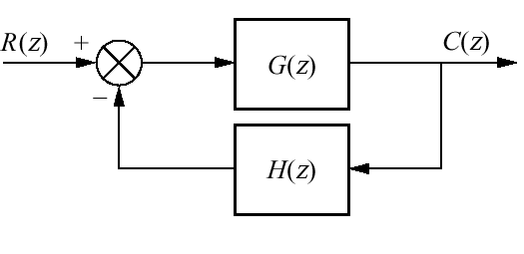
Figure 13.20
Generic digital
feedback control
system

Slide 22
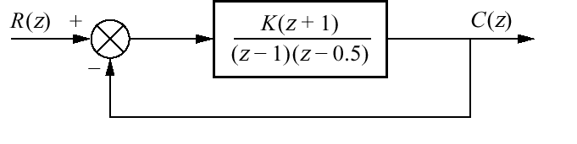
Figure 13.21
Digital feedback
control for
Example 13.10

Slide 23
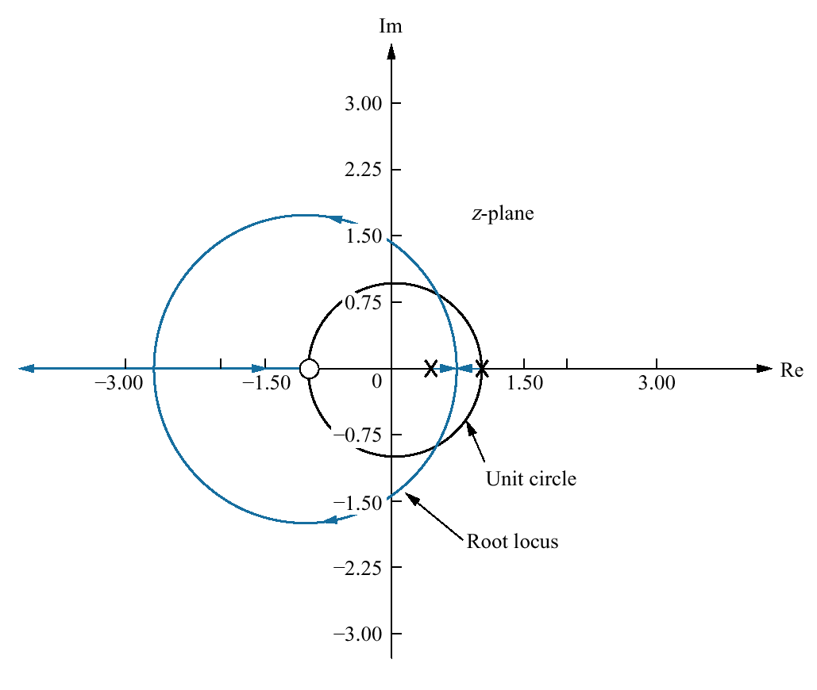
Figure 13.22
Root locus
for the system
of Figure 13.21

Slide 24
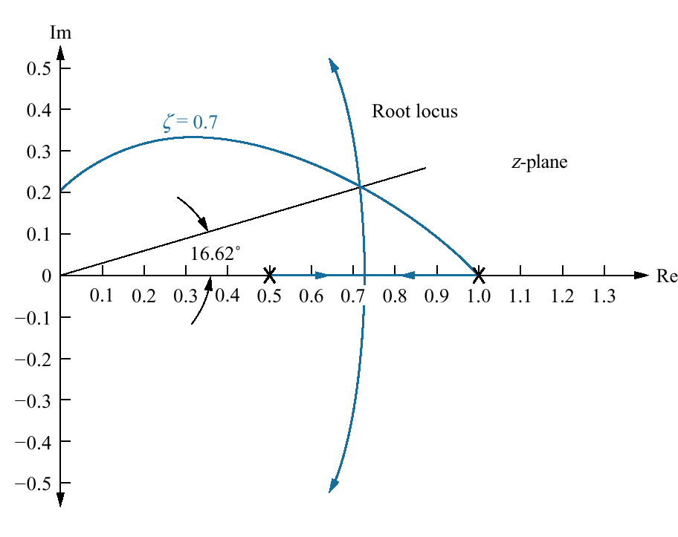
Figure 13.23
Root locus for the
system of Figure
13.21 with constant
0.7 damping ratio
curve

Slide 25
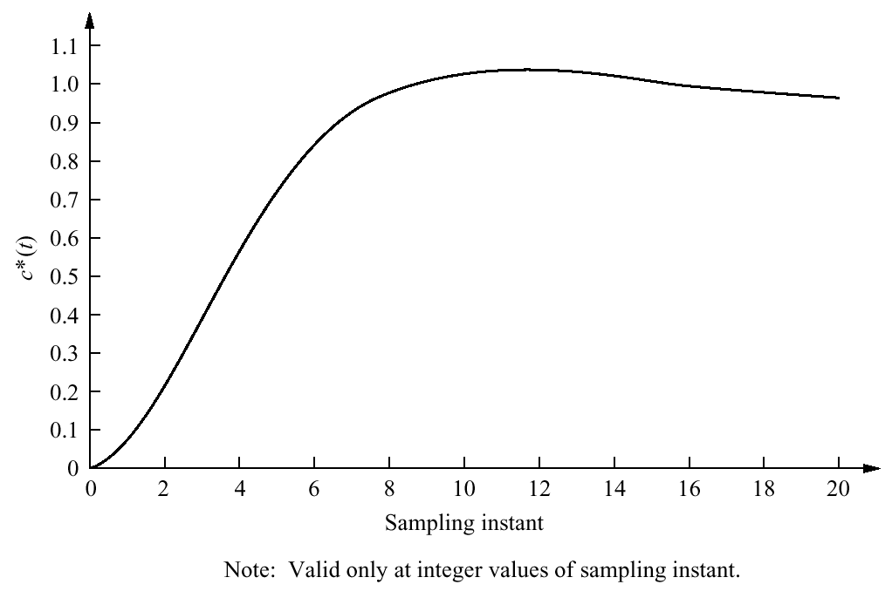
Figure 13.24
Sampled step
response of the
system of
Figure 13.21 with
K = 0.0627

Slide 26
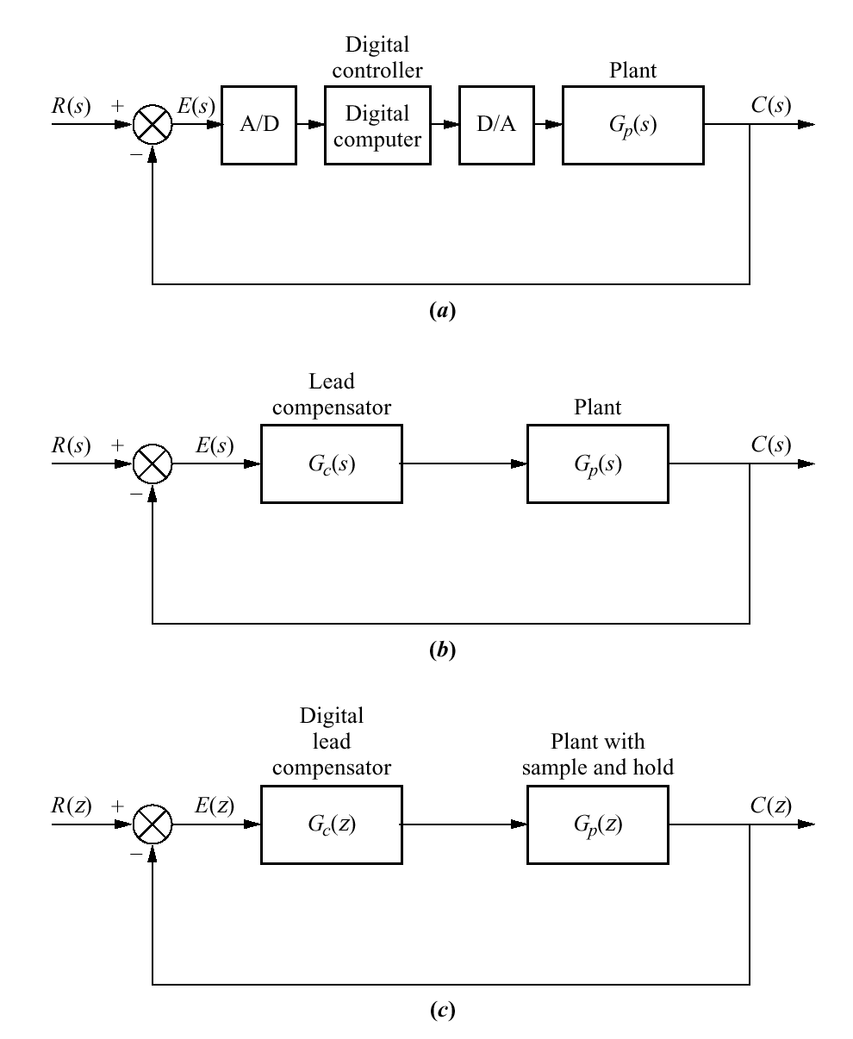
Figure 13.25
a. Digital control
system showing the
digital computer
performing
compensation;
b. continuous system
used for design;
c. transformed digital
system

Slide 27
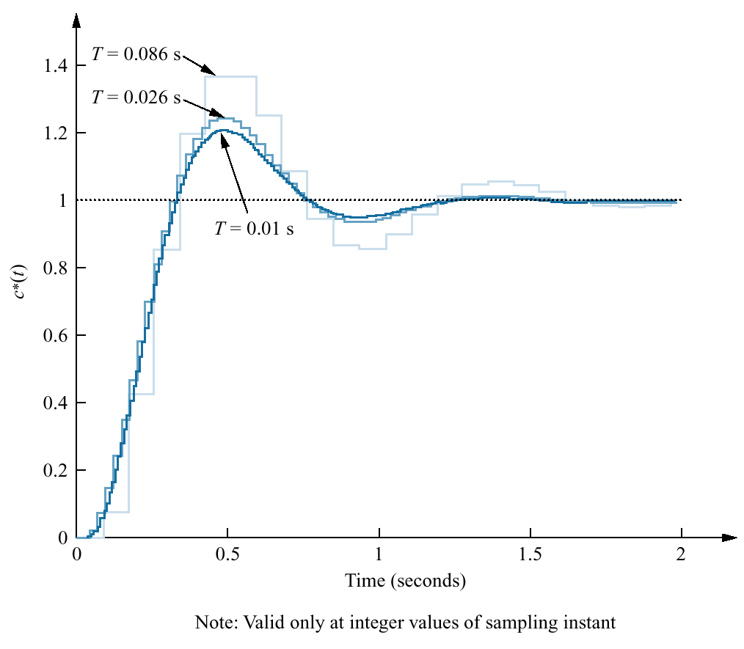
Figure 13.26
Closed-loop response
for the compensated
system of Example
13.12 showing effect
of three different
sampling frequencies

Slide 28
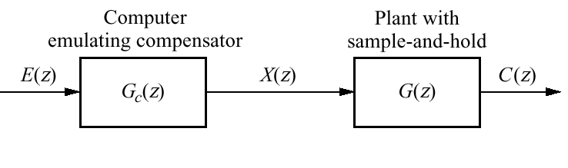
Figure 13.27
Block diagram
showing computer
emulation of a digital
compensator

Slide 29
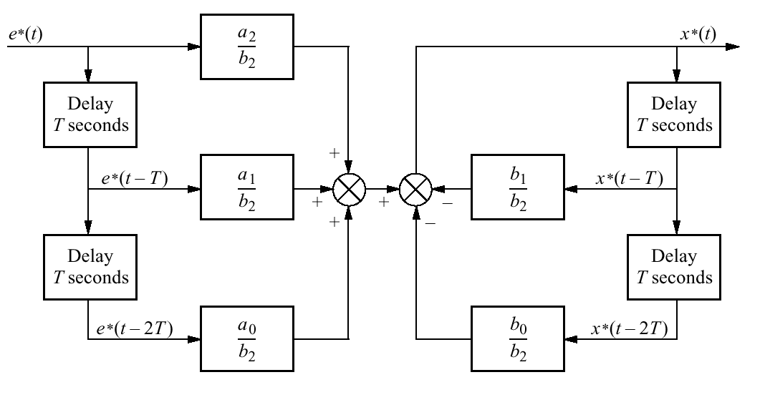
Figure 13.28
Flowchart for
a second-order
digital compensator

Slide 30
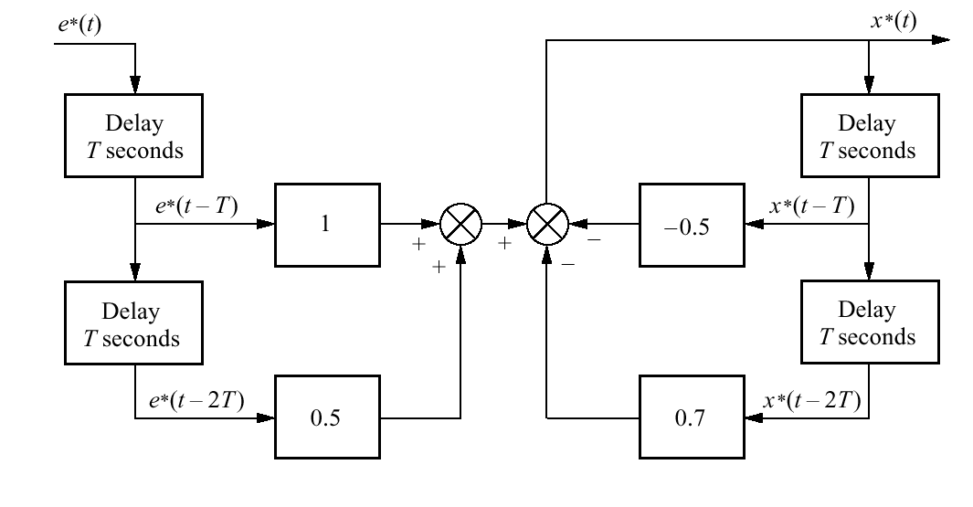


Figure 13.29
Flowchart to
implement

Slide 31
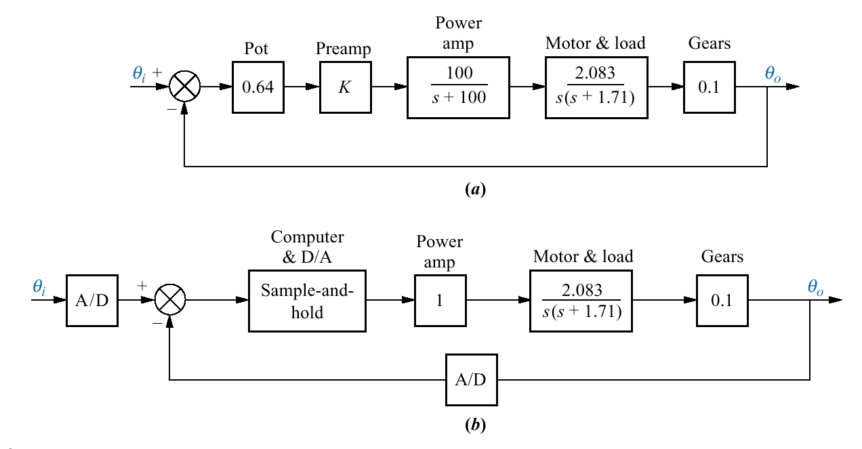
Figure 13.30
Antenna control
system:
a. analog
implementation;
b. digital
implementation

Slide 32
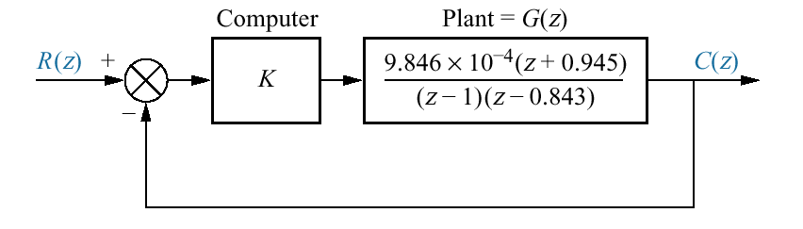
Figure 13.31
Analog antenna
azimuth position
control system
converted to a digital
system

Slide 33
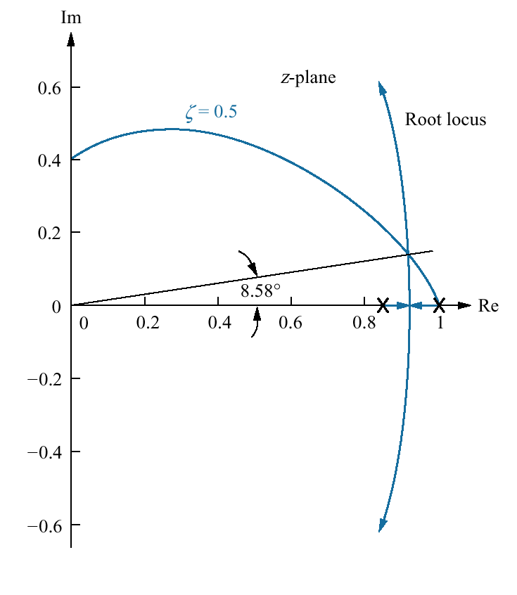
Figure 13.32
Root locus
superimposed over
constant damping
ratio curve

Slide 34
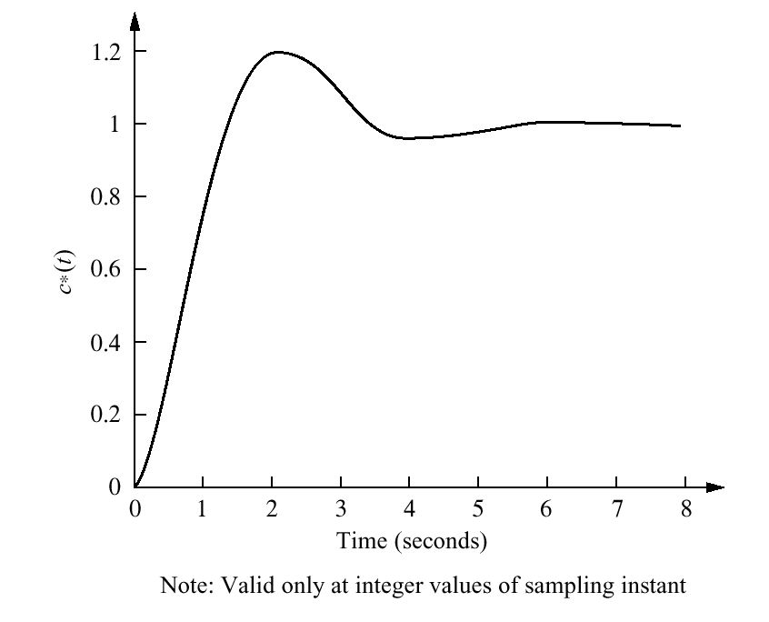
Figure 13.33
Sampled step
response of the
antenna azimuth
position control
system

Slide 35
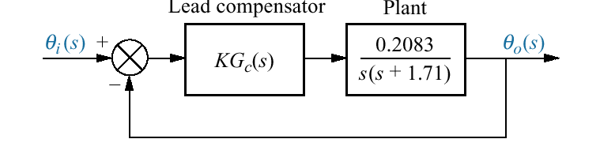
Figure 13.34
Simplified block
diagram of antenna
azimuth control
system

Slide 36
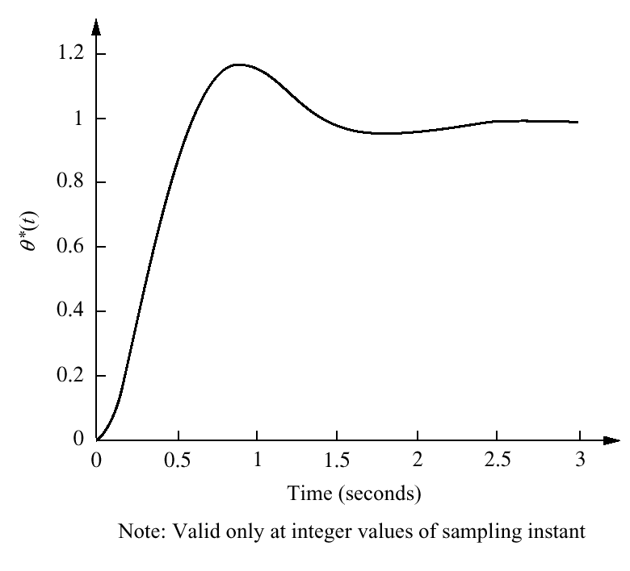
Figure 13.35
Closed-loop digital
step response for
antenna control
system with a lead
compensator.

Slide 37
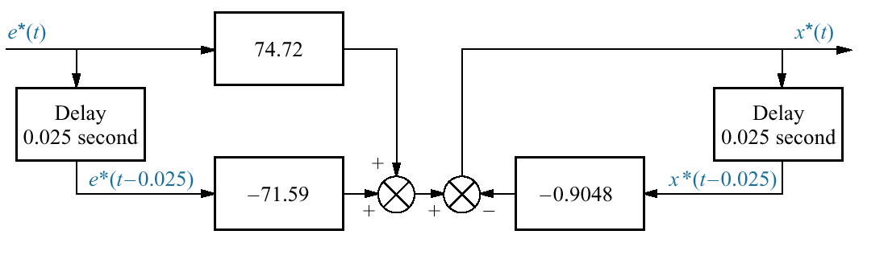
Figure 13.36
Flowchart for lead
digital compensator

Slide 38
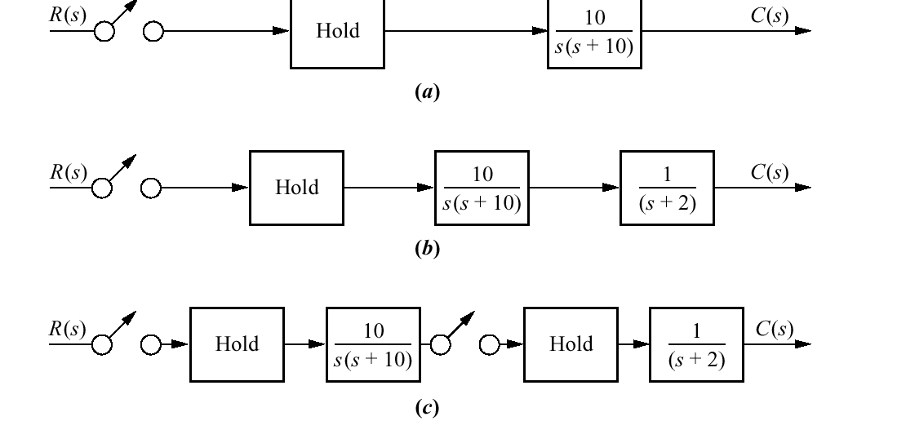
Figure P13.1

Slide 39
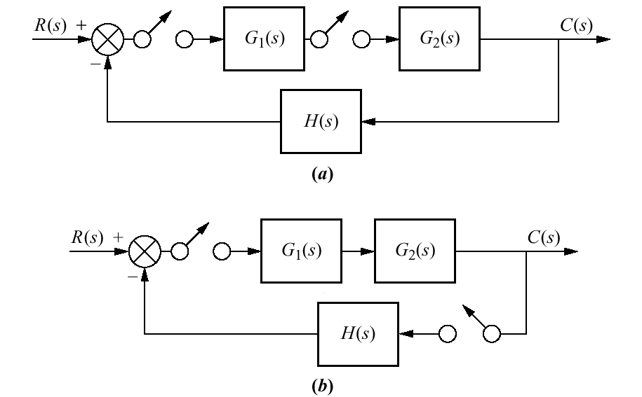
Figure P13.2

Slide 40
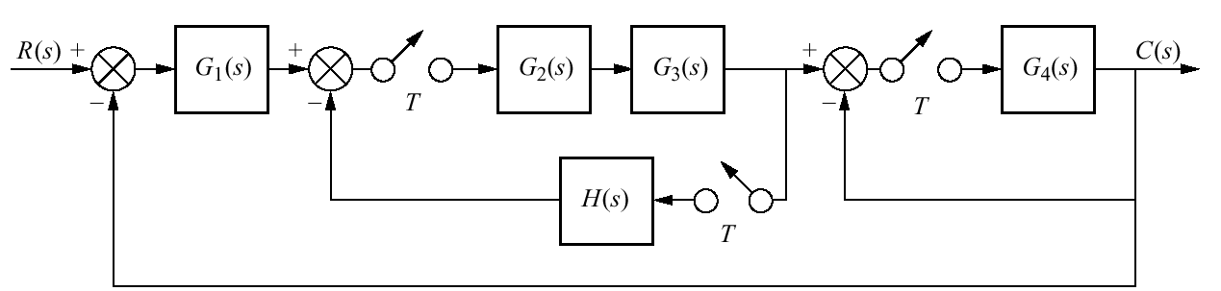
Figure P13.3

Slide 41
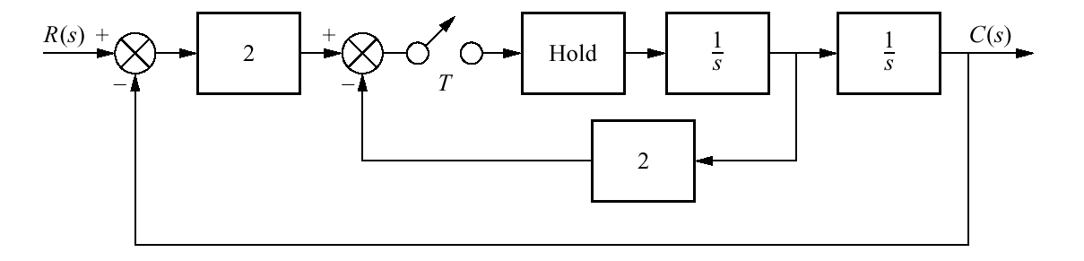
Figure P13.4

Slide 42
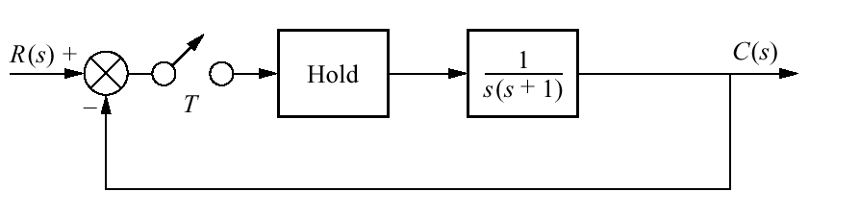
Figure P13.5

Slide 43
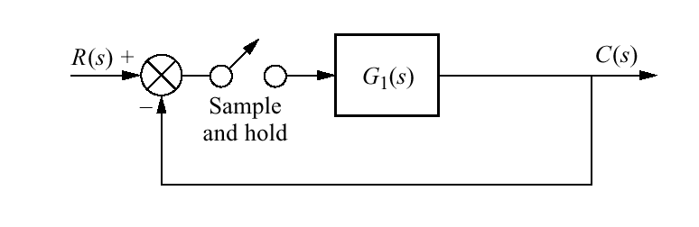
Figure P13.6

Slide 44
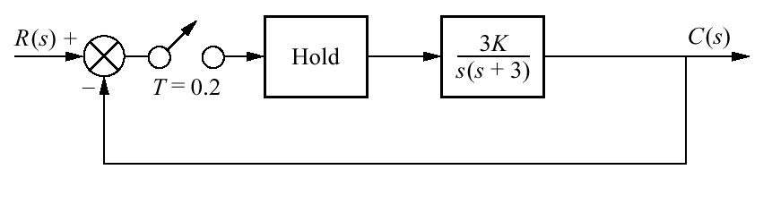
Figure P13.7

Slide 45
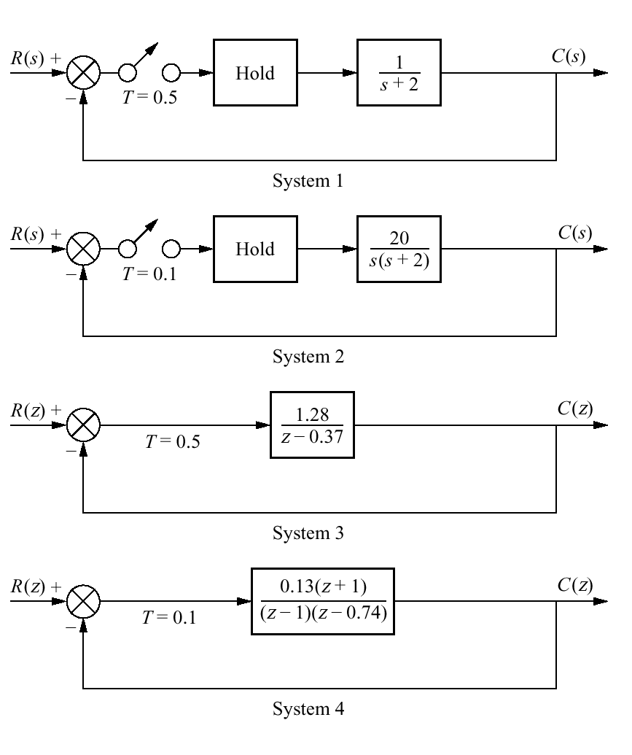
Figure P13.8

Slide 46
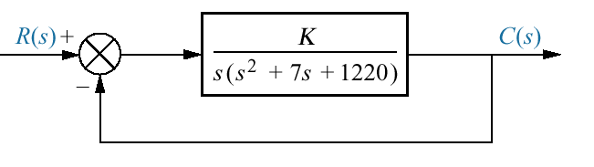
Figure P13.9
Simplified block
diagram for robot
swing motion

Slide 47
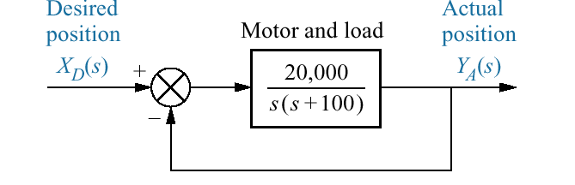
Figure P13.10
Simplified block
diagram of a floppy
disk drive

